Slide 1
Zeesoft
Open Source Artificial Cognition

Slide 2
Zeesoft
Question;”If I had a software company, what kind of software would I want to create?”
Answer; “Mind expanding software”
Github; https://github.com/DyzLecticus/Zeesoft

Slide 3
My background
Programming music since 1995
Programming software professionally since 1998
First artificial life simulation in 2007
Read a lot of philosophy of mind;
  Language and Mind (N. Chomsky)
  Godel Escher Bach (D. Hofstadter)
  I Am a Strange Loop (D. Hofstadter)
  The Mind's I (D. Hofstadter & D. Dennet)
  Consciousness explained (D. Dennet)
  Confabulation Theory (R. Hecht-Nielsen)

Slide 4
Confabulation Theory
Proposes that cognition is a phylogenetic outgrowth of movement and that cognition utilizes the same neural circuitry that was originally developed for movement.
Cognition is a result of coordinated brain muscle contractions that manipulate mental objects.
Brain muscles are called modules.
Mental objects are called symbols.
Knowledge links connect co-occurring symbols
Humans are thought to have about 4000 modules.
Maximization of cogency (non Bayesian)

Slide 5
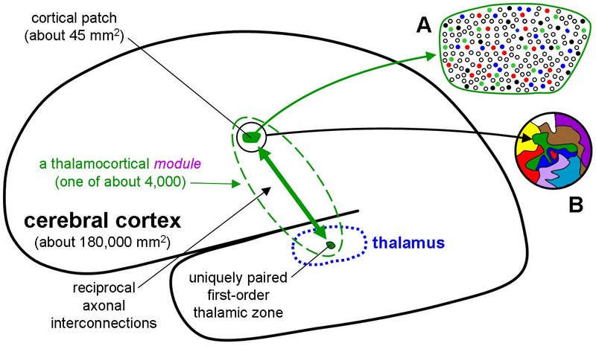
Confabulation Theory

Slide 6
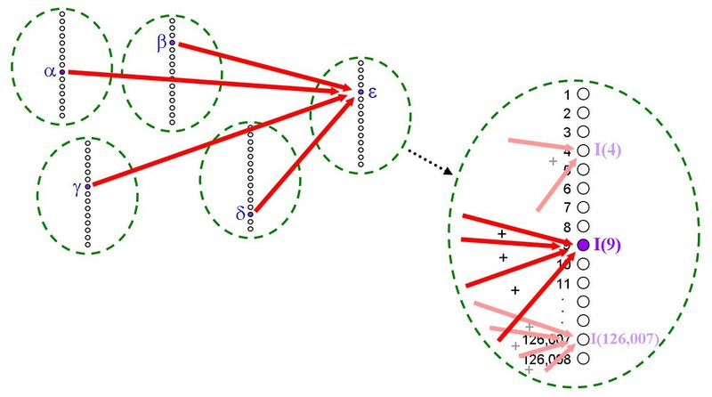
Confabulation Theory

Slide 7
My interpretation
Input; a sequence of symbols and optionally some context symbols (i.e. a sentence and some subject words)
For each context symbol to associate with the sequence
  For each symbol pair over a certain maximum distance
      Create a knowledge link or increment the counter on the existing link
      If one of the link counters reaches a certain maximum, divide all link counters by 2

Slide 8
My interpretation
Confabulation is using the knowledge links to activate symbols in modules in a very particular way (non Bayesian).
The most activated symbol is the module conclusion.
Confabulation explores all learned (future) paths simultaneously.

Slide 9
My software
Zeesoft Development Kit
  Extended StringBuilders, Multi threading, Self document and testing
Zeesoft Symbolic Confabulation
Zeesoft Symbolic Pattern Recognition
  Translate symbolic patterns into machine readable values and back
Zeesoft Intelligent Dialogs
  Combines ZDK, ZSC and ZSPR
  Translates written dialogues into program calls

